Slide 1

DSE 2256 DESIGN & ANALYSIS OF ALGORITHMS Lecture 8 & 9 Mathematical Analysis of Recursive Algorithms

Slide 2
Recap of L6 & L7
Mathematical analysis of non-recursive algorithms
General Plan for analysing time efficiency
Summation formulas
Algorithm : Max. element in an array
Algorithm : Unique elements in an array
Algorithm : Multiplication of two n x n matrices

Slide 3
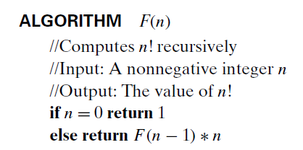

Mathematical analysis of Recursive Algorithms I
Example 1: Factorial of a number
Definition:
n! = 1 ∗ 2 ∗ … ∗(n-1) ∗ n, for n ≥ 1 and, 0! = 1
Recursive definition:
F(n) = F(n-1) ∗ n, for n ≥ 1 and,
F(0) = 1
Input size | :
Basic Operation | :
Recurrence relation | :
n
Multiplication
M(n) = M(n-1) + 1 M(0) = 0

Slide 4
Mathematical analysis of Recursive Algorithms II
Example 1: Solving the recurrence for M(n)
M(n) = M(n-1) + 1
M(0) = 0
M(n) = M(n-1) + 1
= (M(n-2) + 1) + 1 = M(n-2) + 2
= (M(n-3) + 1) + 2 = M(n-3) + 3
…
= M(n-i) + i
...
= M(0) + n
= n
The method is called backward substitution.
M(0) = 0

Slide 5
Mathematical analysis of Recursive Algorithms III
Example 1: Solving the recurrence for M(n)
M(n) = M(n-1) + 1
M(0) = 0
M(n) = M(n-1) + 1
= (M(n-2) + 1) + 1 = M(n-2) + 2
= (M(n-3) + 1) + 2 = M(n-3) + 3
…
= M(n-i) + i
...
= M(0) + n
= n
The method is called backward substitution.
M(0) = 0

Slide 6
Mathematical analysis of Recursive Algorithms IV
General Plan for Analysis of Recursive Algorithms:
Decide on a parameter indicating an input’s size.
Identify the algorithm’s basic operation.
Check whether the number of times the basic operation is executed may vary on different inputs of the same size.
Set up a recurrence relation with an appropriate initial condition expressing the number of times the basic operation is executed.
Solve the recurrence by backward substitutions or another method.

Slide 7
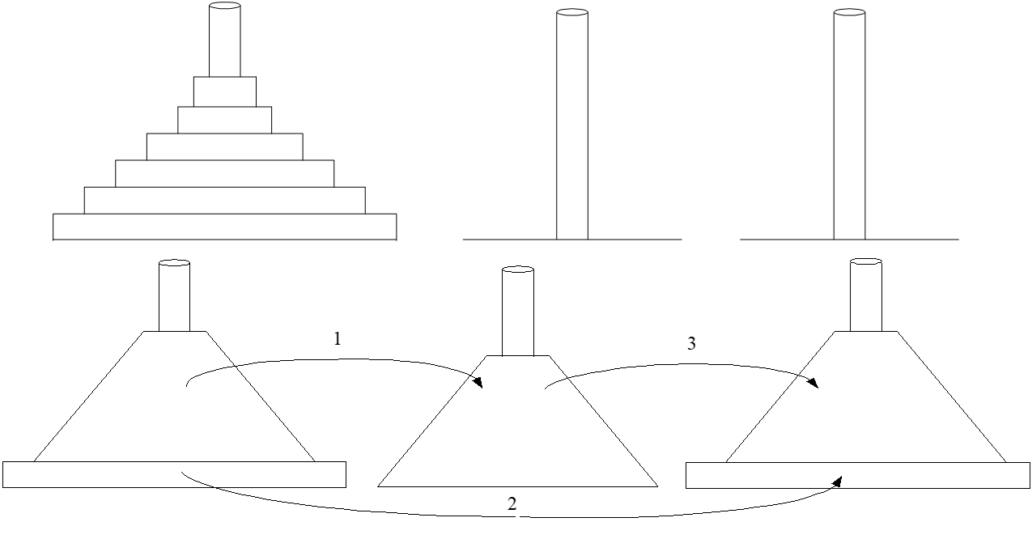
Mathematical analysis of Recursive Algorithms V
Example 2: Tower of Hanoi
ALGORITHM Tower_of_hanoi (n,s,d,a) // Recursively moves disks from source (s) to destination (d) // Input : the no. of disks (n), source (s), destination (d), auxiliary (a) towers. Initially, a and d towers are empty. // Output is the sequence of moves
if (n==1) then do
print (“Move from s to d”)
return
else
Tower_of_hanoi (n-1, s, a, d)
print (“Move from s to d”)
Tower_of_hanoi (n-1, a, d, s)
end if

Slide 8
Mathematical analysis of Recursive Algorithms VI
Solving recurrence for number of moves:
M(n) = 2M(n-1) + 1, M(1) = 1
M(n) = 2M(n-1) + 1
= 2(2M(n-2) + 1) + 1 = 2²*M(n-2) + 2¹ + 2⁰
= 2² *(2M(n-3) + 1) + 2¹ + 2⁰
= 2³*M(n-3) + 2² + 2¹ + 2⁰
= …
= 2^{n-1}*M(1) + 2^{n-2} + … + 2¹ + 2⁰
= 2^{n-1} + 2^{n-2} + … + 2¹ + 2⁰
= 2^{n}- 1

Slide 9
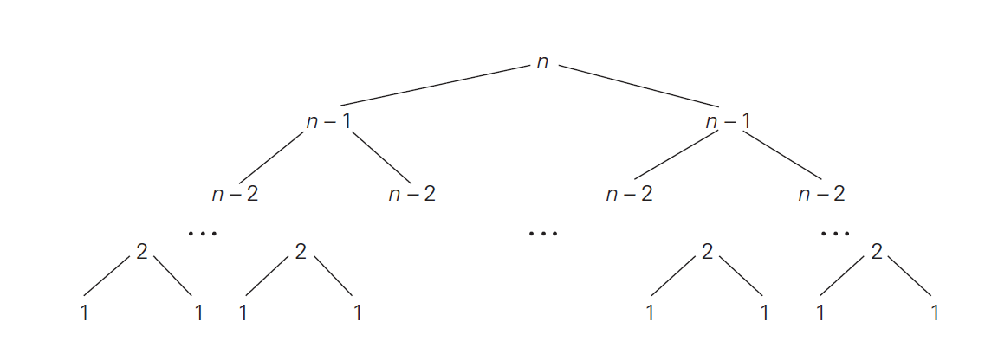
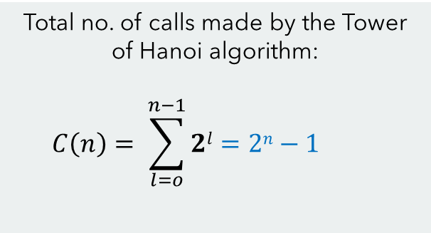
Mathematical analysis of Recursive Algorithms VII
Total no. of calls made by the Tower of Hanoi algorithm:
$$C\left(n\right)= \sum_{l=o}^{n−1}{2l}=2n−1$$

Slide 10
Thank you!
Any queries?
Notes:
Cannot find exact value and can only be approximated

